Slide 1
Search for electroweakinos production in compressed region
Speaker: Chengxin Liao(廖诚鑫)
On behalf of IHEP SUSY group
May, Tue 27, 2025

Slide 2
Outline
1. Introduction
2. Ntuple & Events construction
2.1 Ntuple setup
2.2 Events construction & trigger
3. SRs definition
3.1 HH channel
3.2 LH channel
4. Background estimation
4.1 HH channel
4.2 LH channel
5. Sensitivity map
6. Summary and Outlook

Slide 3
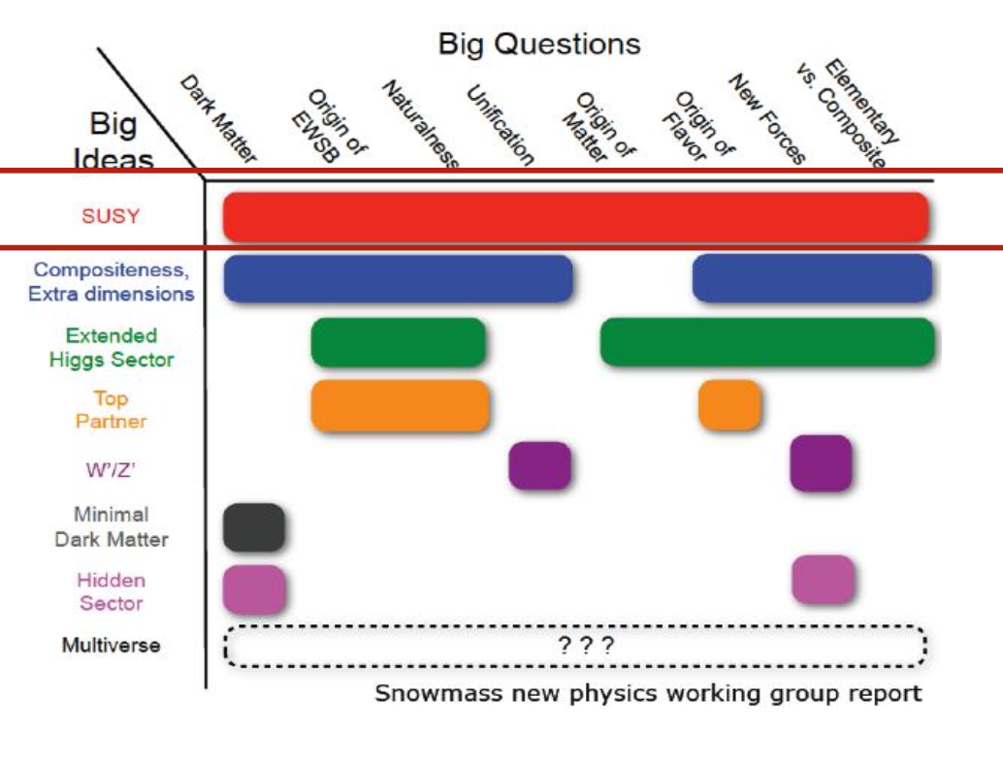
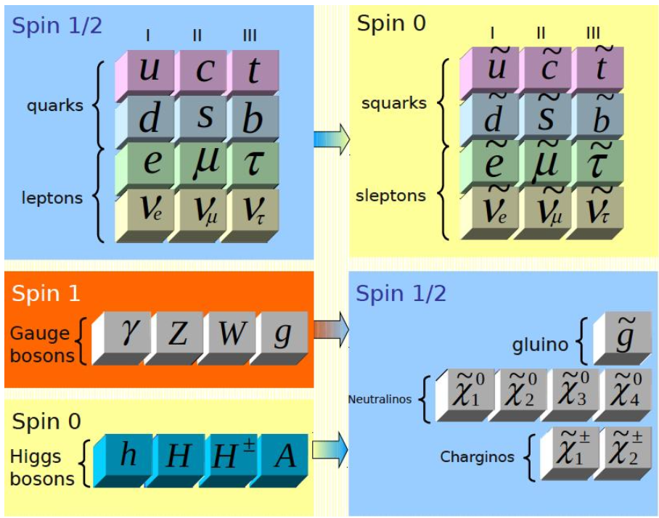
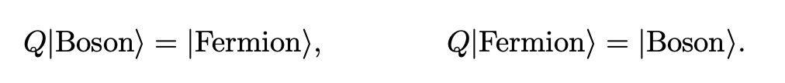
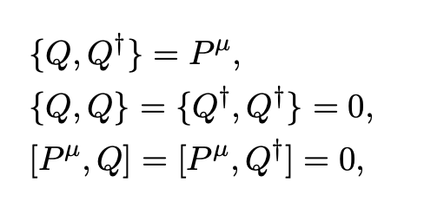
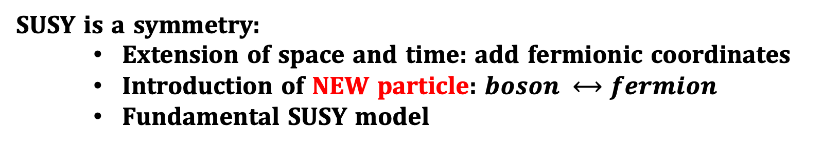
Introduction
Why SUSY
Provide Dark matter candidate
Unification of gauge coupling
Solve the hierarchy problem
……
SUSY is a symmetry:
Extension of space and time: add fermionic coordinates
Introduction of NEW particle: $boson ⟷fermion$
Fundamental SUSY model

Slide 4
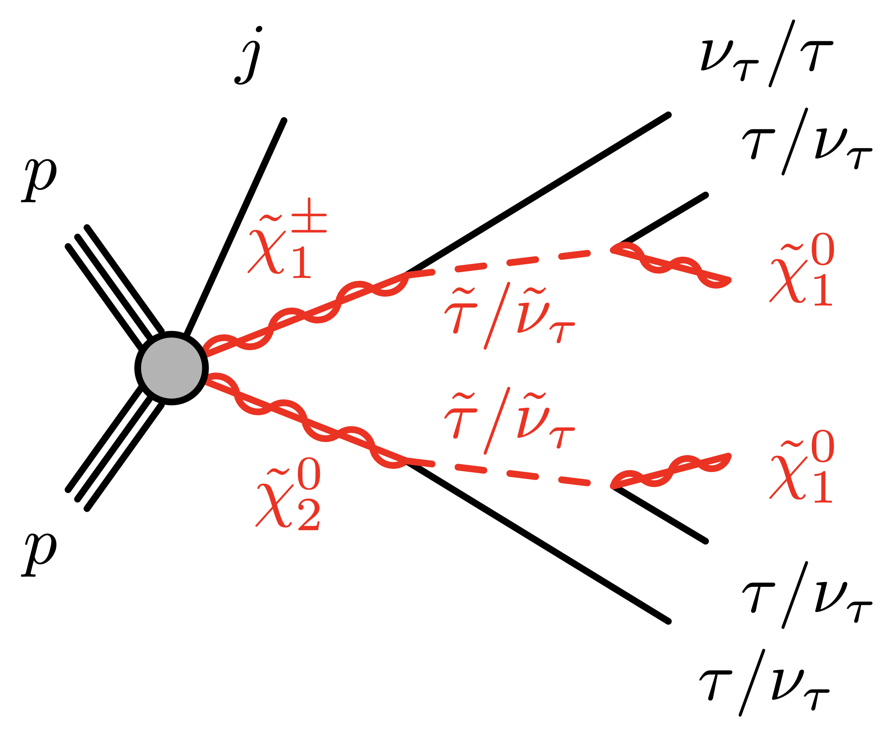
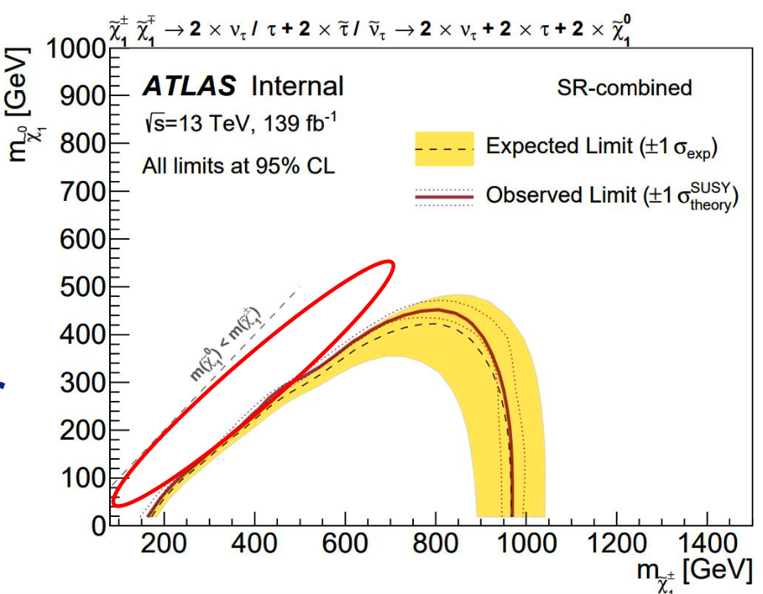
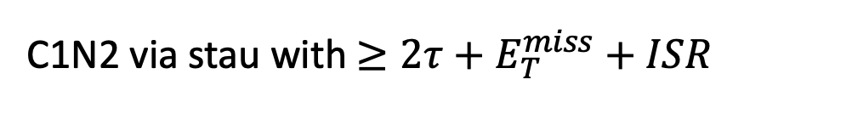

Motivation & Stragety
C1N2 via stau with $≥2τ+E_{T}^{miss}+ISR$
Motivation: Exclusion limit on C1/N2-N1 mass plane is derived. Still a gap in region with small $∆m$ ISR can boost the SUSY system and improve the sensitivity in compressed region
Stragety:
BDT method to optimize SRs(HH and LH channel)
Fake taus with Fake Factor method
Real taus scaled with CRs and validate with VRs
Previous paper: JHEP 05 (2024) 150

Slide 5
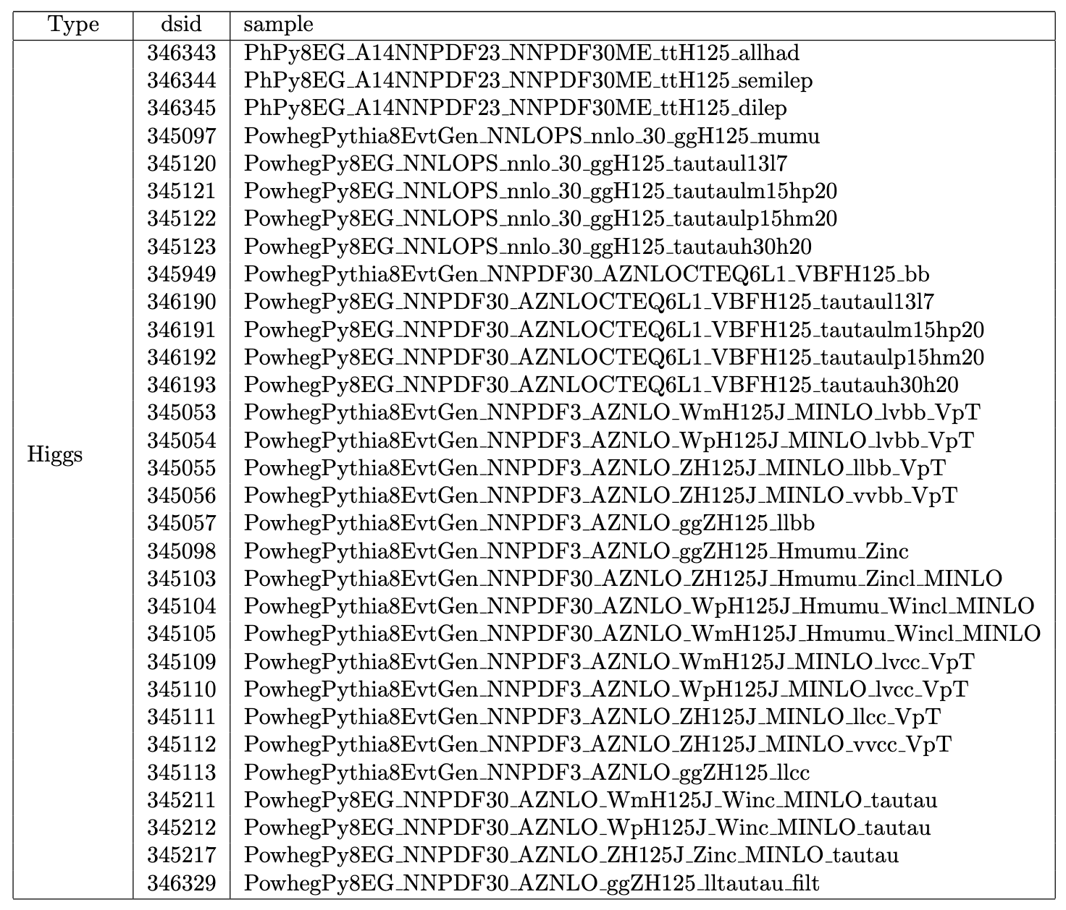
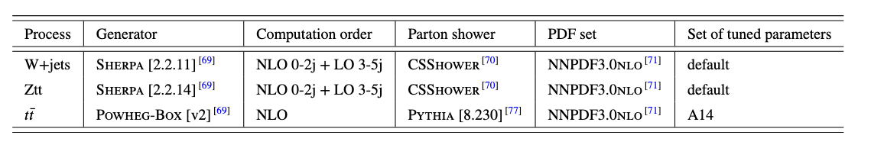
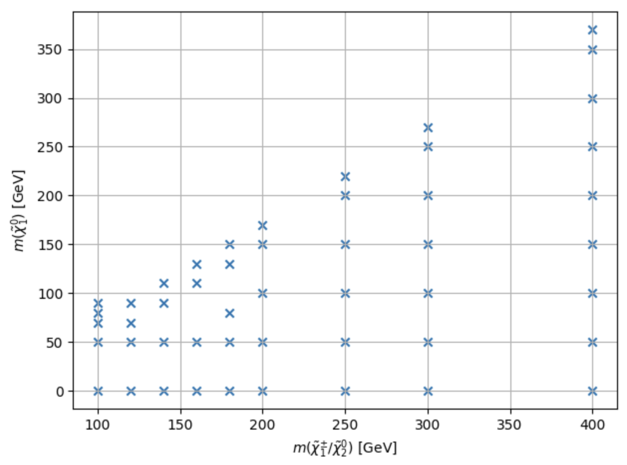
Ntuple setup
MelAnalysis framework
Dataset: full run2 + partial run3
DAOD PHYS
ptag: signal p6244, bkg p6490/p6491, data p6479/p6269
background list: mc20, mc23;
main background
${\tilde{χ}}_{1}^{±}$ and ${\tilde{χ}}_{2}^{0}$ mass degenerate and pure wino
$\tilde{τ}/\tilde{ν}$ mass degenerate and lie midway between ${\tilde{χ}}_{1}^{±}$ and ${\tilde{χ}}_{2}^{0}$
(100,70)
Filter set: 1. basic grids with 2TFilt
2. grids in compressed region with 1TFilt

Slide 6
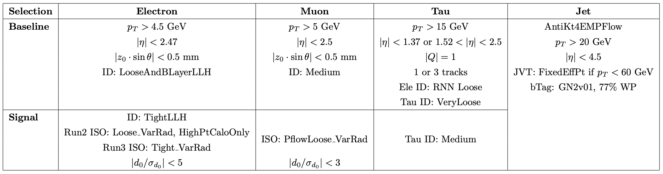
Object Definition
Full ST config: Run2, Run3
Follow the CP recommendation
Decrease from 20GeV to 15GeV

Slide 7
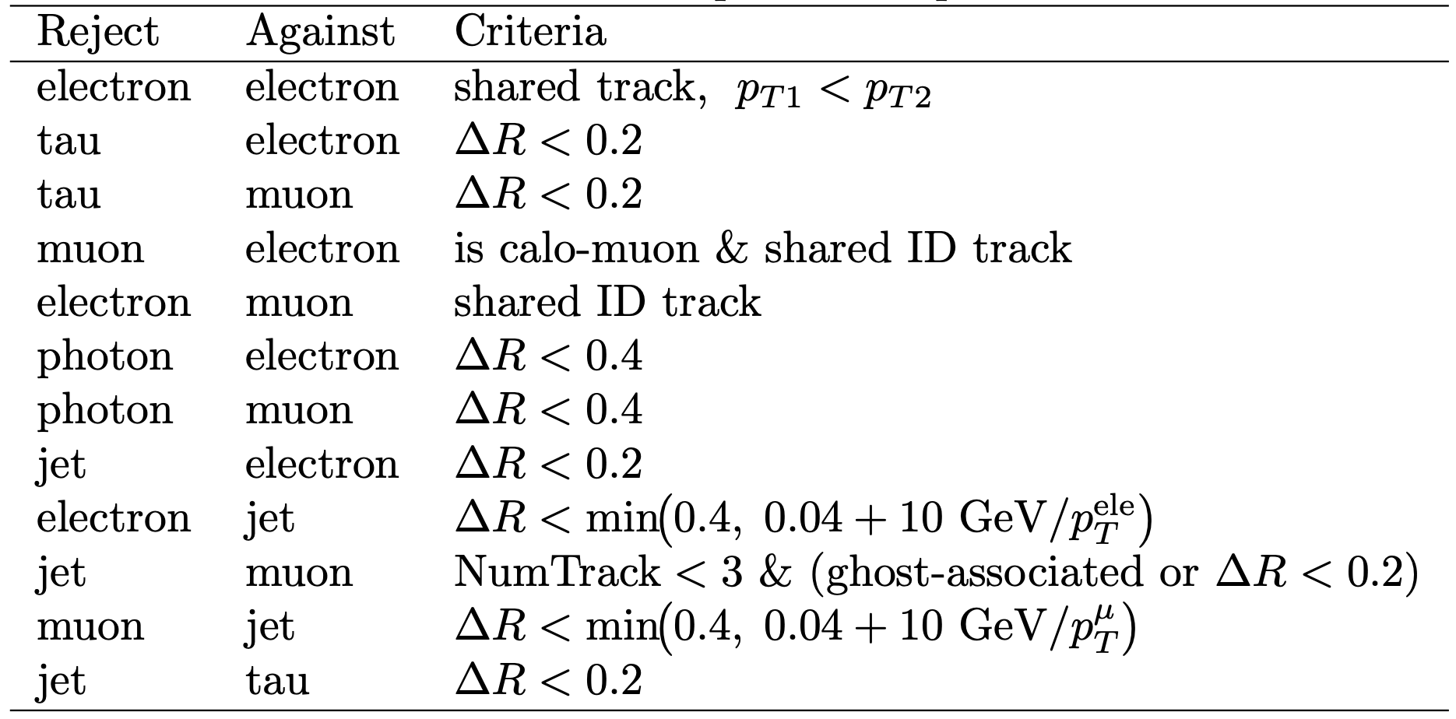
Overlap Removal
ST default overlap removal
Do Tau OLR

Slide 8
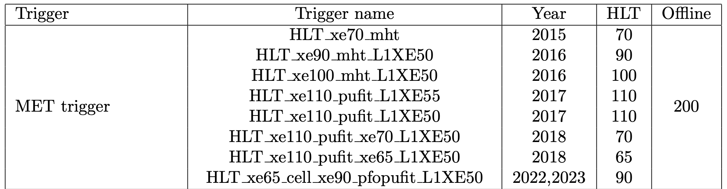
Trigger Strategy
C1N2: MET trigger

Slide 9
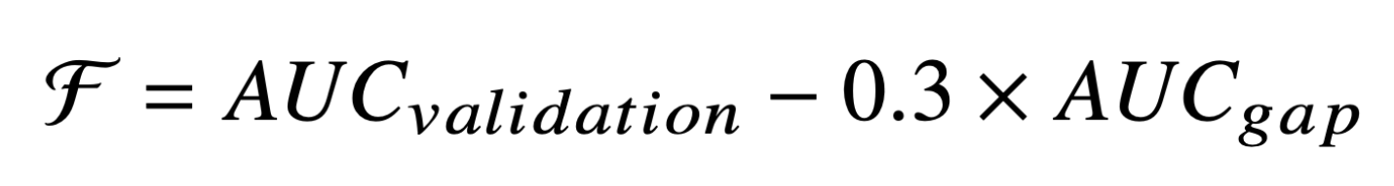
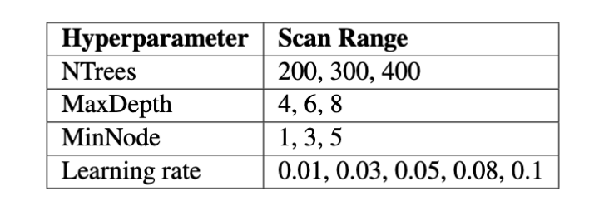
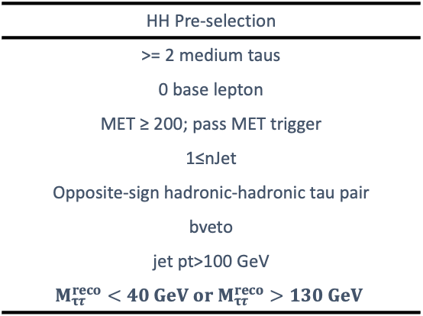
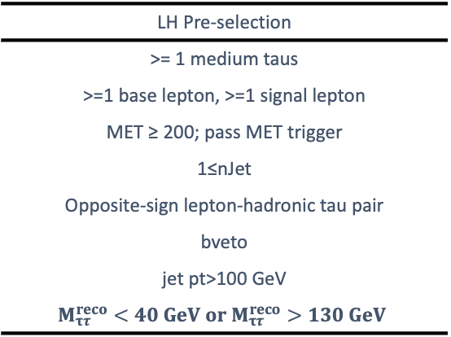
C1N2 ISR signal region optimization
Preselection for HH and LH channel
BDT method for signal region optimization
Figure of merit: AUC
5-fold Cross-Validation
HH Pre-selection
>= 2 medium taus
0 base lepton
MET ≥ 200; pass MET trigger
1≤nJet
Opposite-sign hadronic-hadronic tau pair
bveto
jet pt>100 GeV
$$M_{ττ}^{reco}<40 GeV or M_{ττ}^{reco}>130 GeV$$
LH Pre-selection
>= 1 medium taus
>=1 base lepton, >=1 signal lepton
MET ≥ 200; pass MET trigger
1≤nJet
Opposite-sign lepton-hadronic tau pair
bveto
jet pt>100 GeV
$$M_{ττ}^{reco}<40 GeV or M_{ττ}^{reco}>130 GeV$$
Penalty function to balance the AUC and overfit
Grid Search for the best model

Slide 10
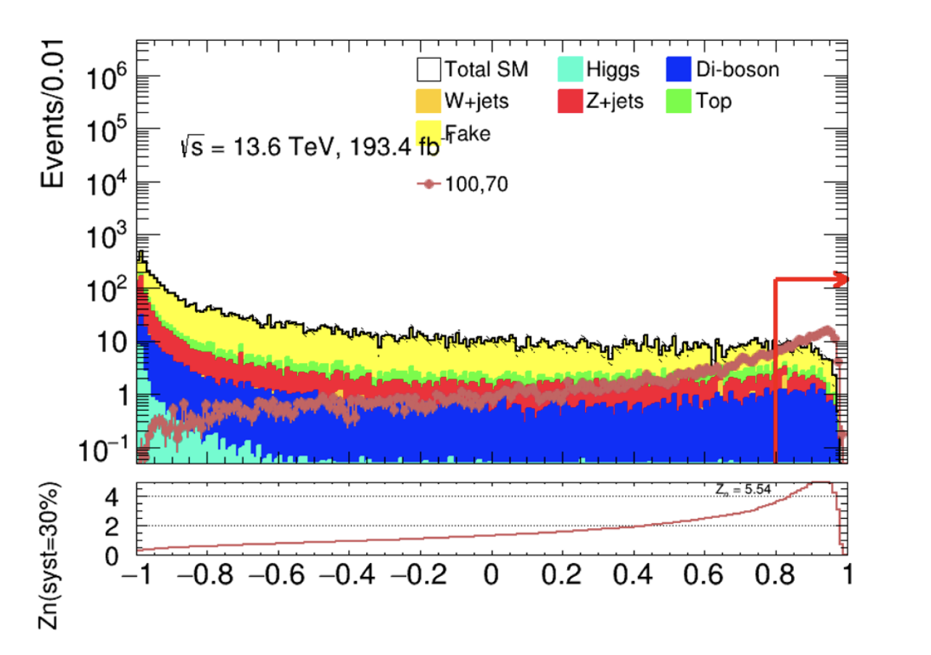
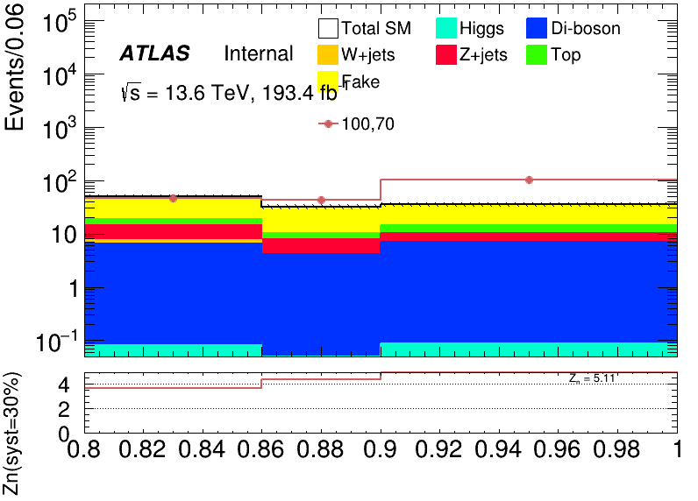
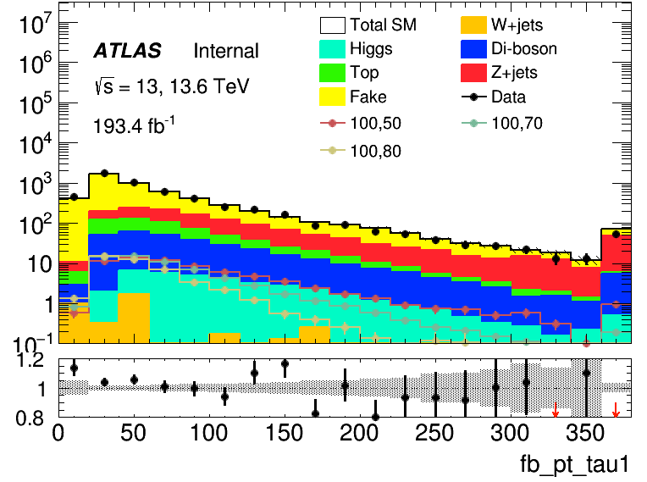
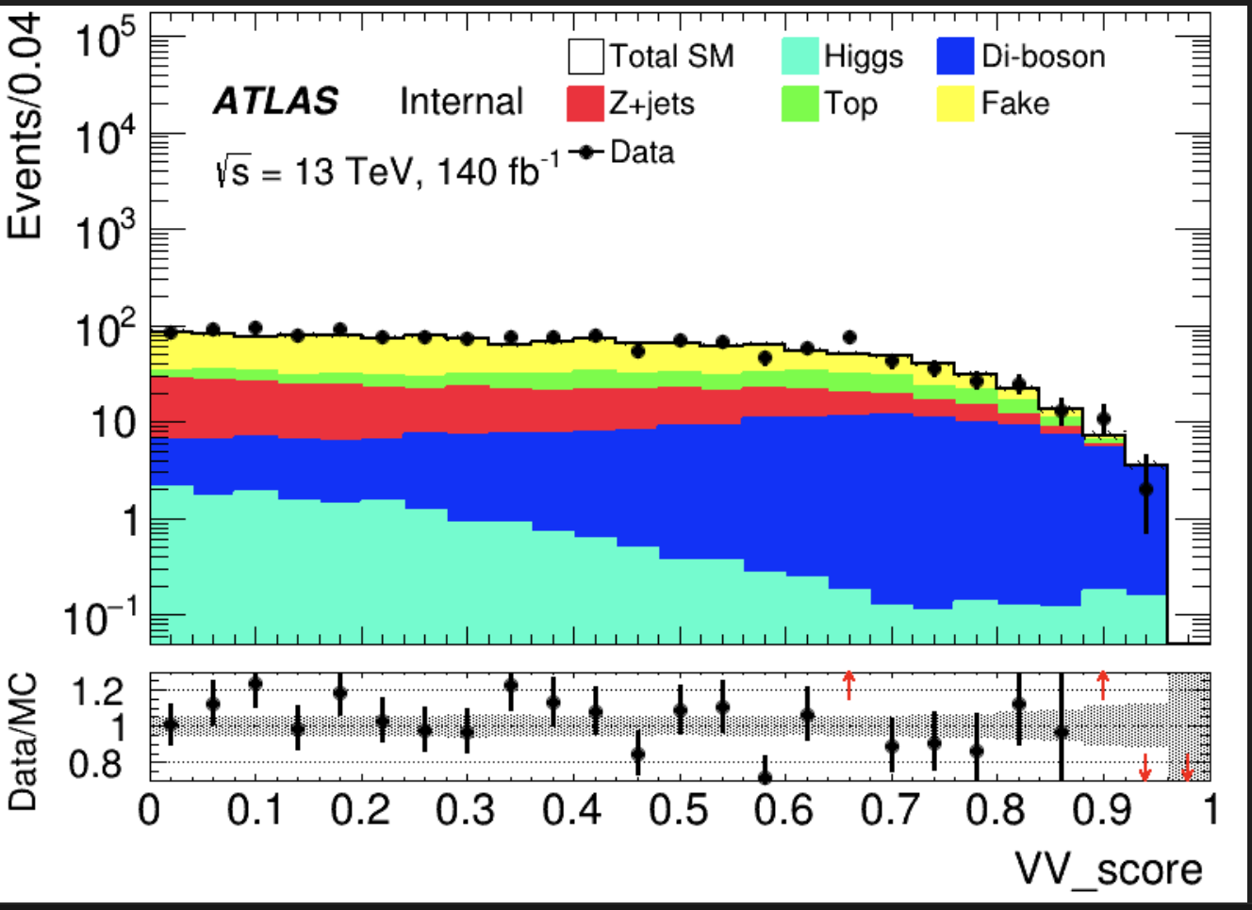
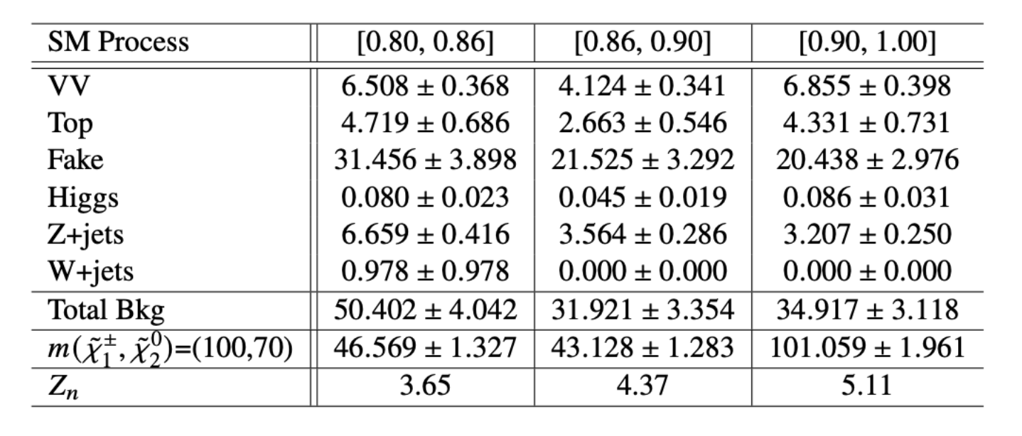
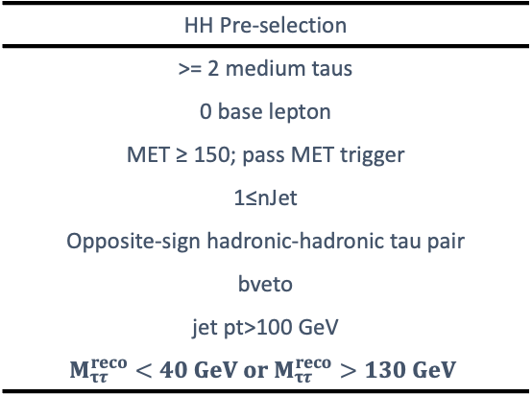
C1N2 ISR signal region definition(HH)
Combined Zn 7.56
SR definition using BDT score(HH)
Three bins [0.80, 0.86], [0.86, 0.90], [0.90, 1.00]
HH Pre-selection
>= 2 medium taus
0 base lepton
MET ≥ 150; pass MET trigger
1≤nJet
Opposite-sign hadronic-hadronic tau pair
bveto
jet pt>100 GeV
$$M_{ττ}^{reco}<40 GeV or M_{ττ}^{reco}>130 GeV$$
SR
Pre-selection
BDT score > 0.8

Slide 11
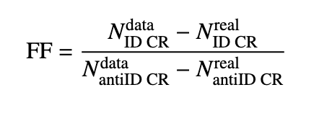
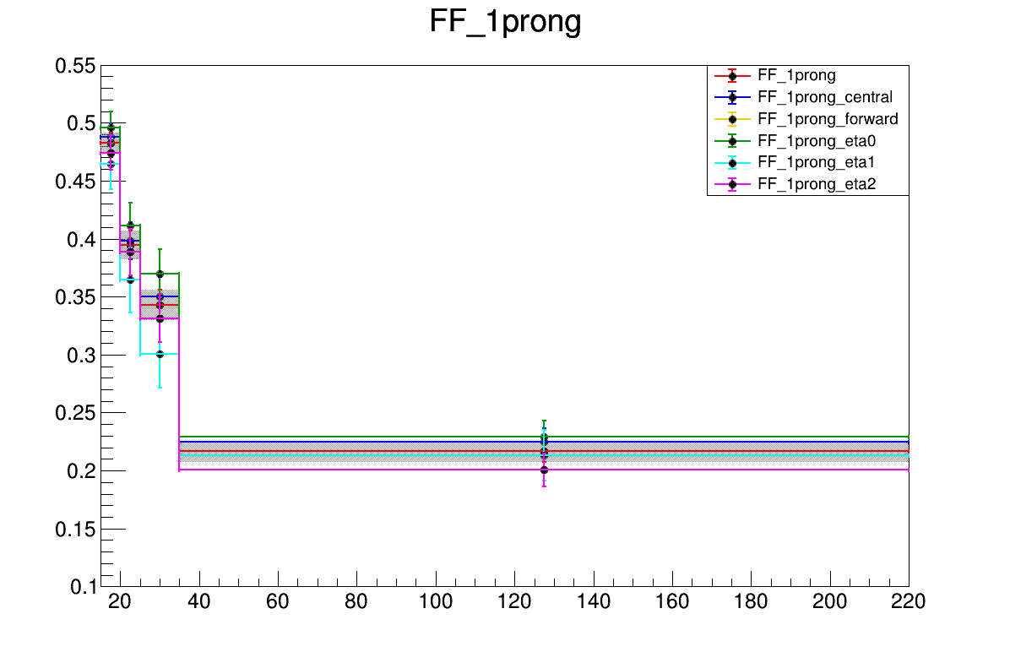
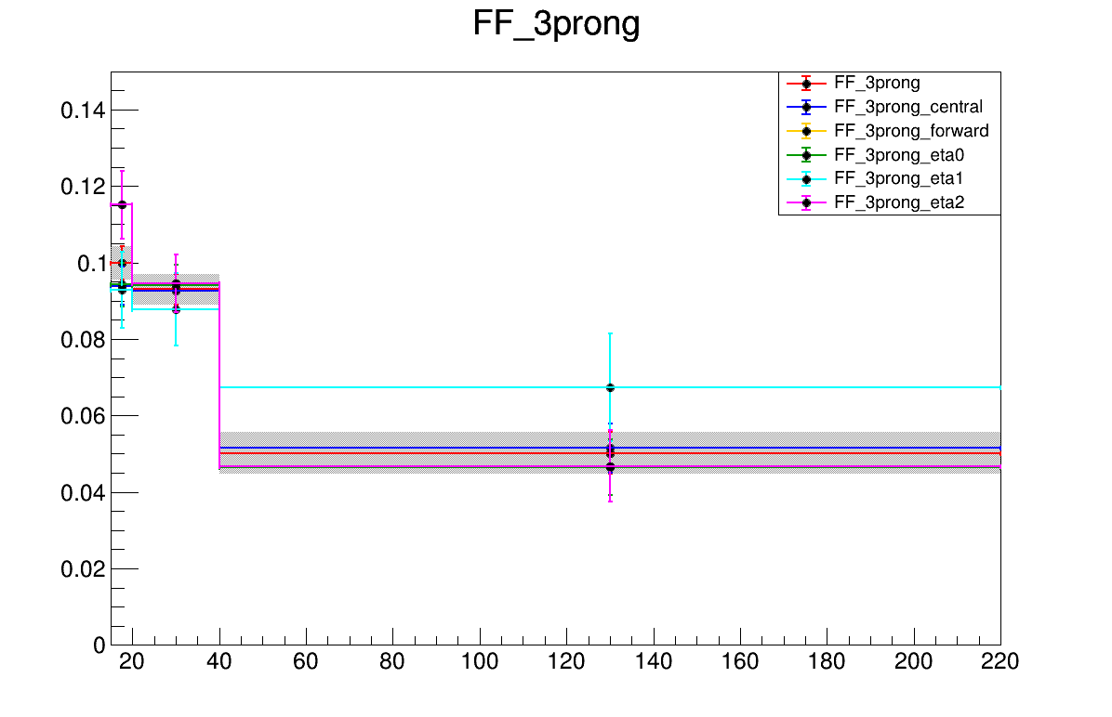
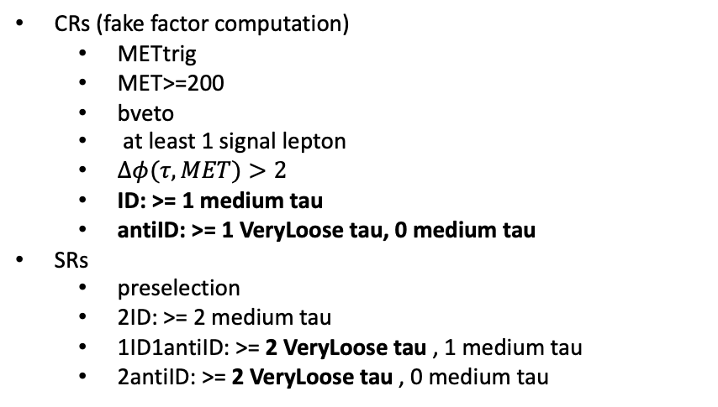
C1N2 ISR fake estimation(HH)
CRs (fake factor computation)
METtrig
MET>=200
bveto
at least 1 signal lepton
$Δφ(τ,MET)>2$
ID: >= 1 medium tau
antiID: >= 1 VeryLoose tau, 0 medium tau
SRs
preselection
2ID: >= 2 medium tau
1ID1antiID: >= 2 VeryLoose tau , 1 medium tau
2antiID: >= 2 VeryLoose tau , 0 medium tau
FF determination
Data
FF determination
Data
CR
Pass ID
SR
Pass ID
SR
but
1 tau Fail ID
CR
Fail ID
SR
but
2 tau Fail ID
Binned in prongness, tau eta, tau pT
Eta bins
2 bins: central [0,1.37], forward [1.52,2.5]
3 bins: eta0,1,2 for [0,1), [1, 1.37], [1.52,2.5]
Auto binning:
> 10% of events in nominator and denominator
Add bins to bin i until it is not consistent anymore with bin i - 1
Relative stat uncertainty on ratio smaller than 50%
>10% events in nominator and denominator

Slide 12
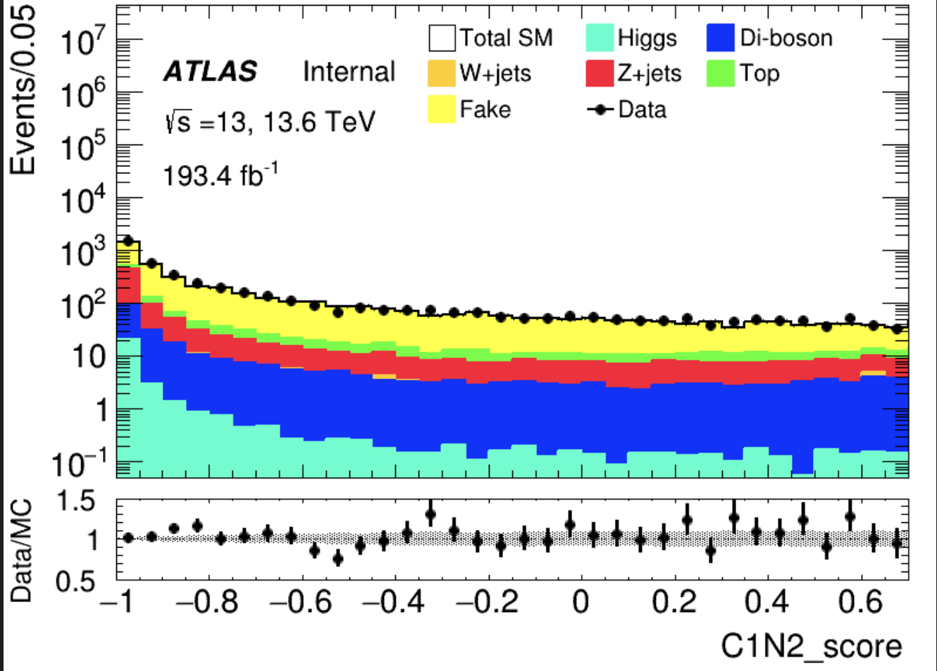
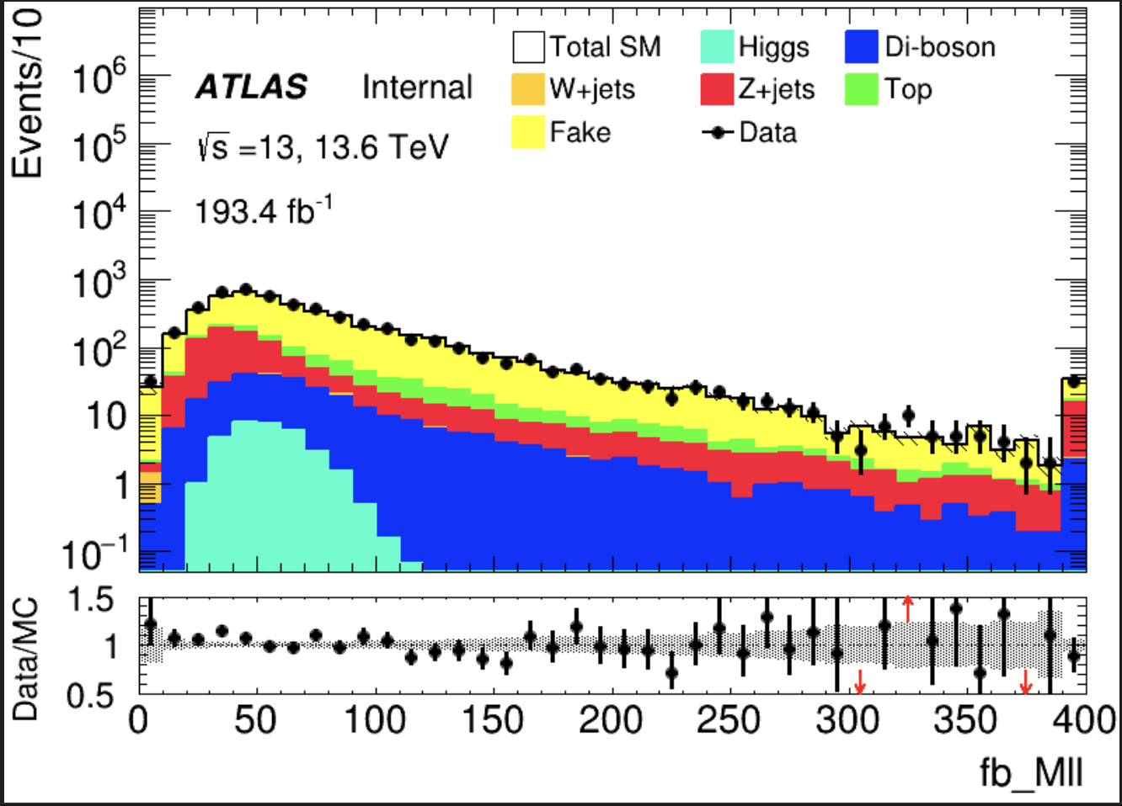
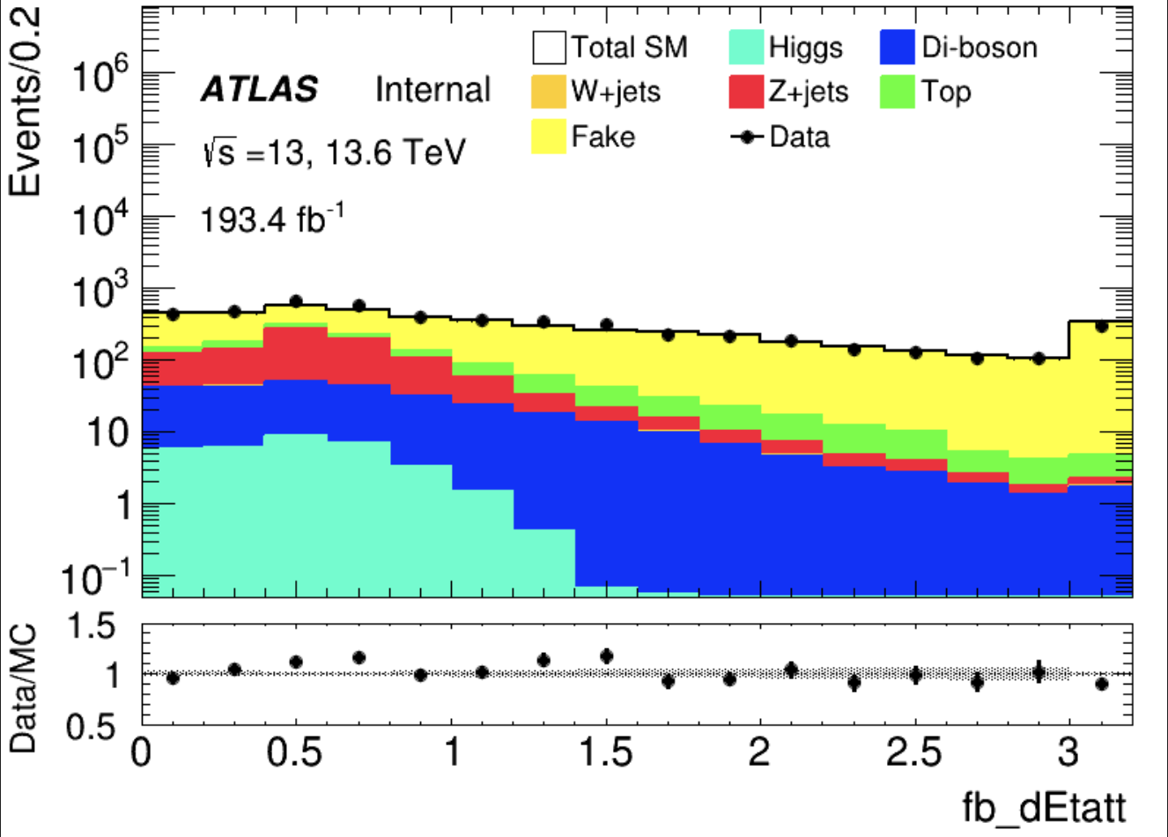
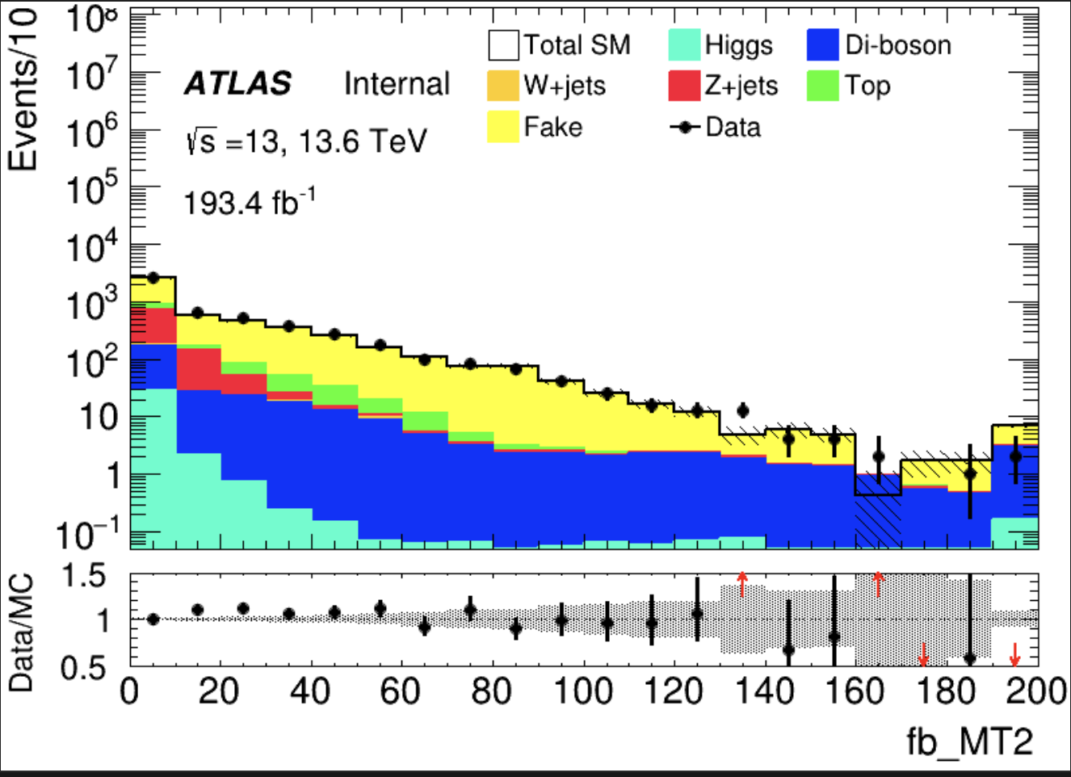
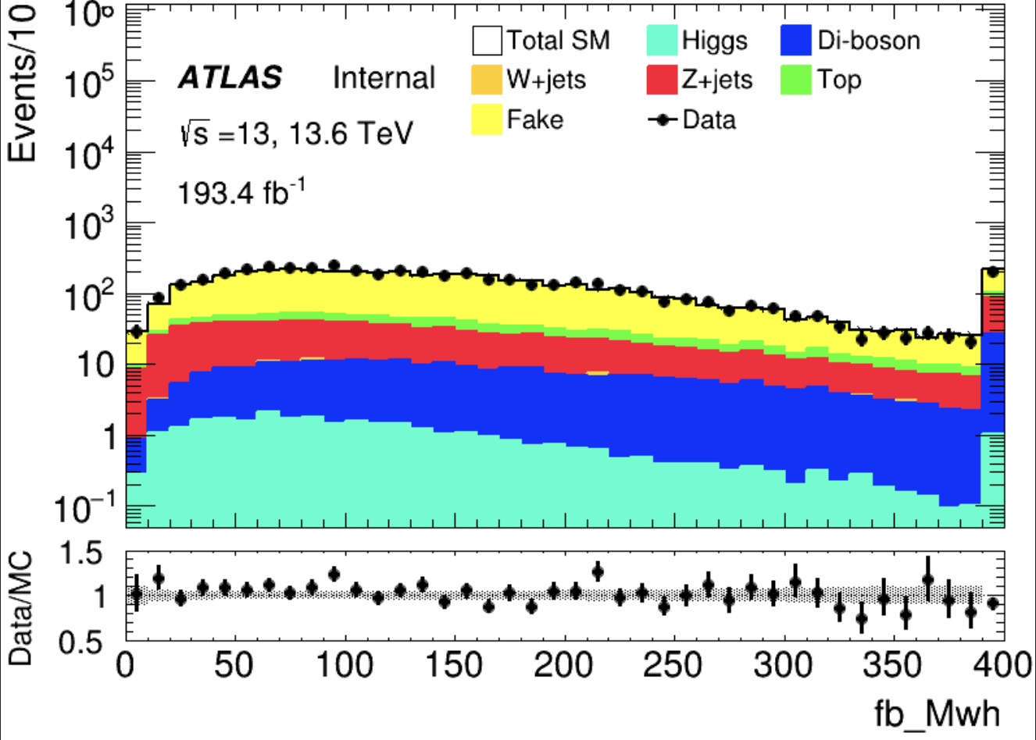
C1N2 ISR fake estimation validation(HH)
Data-driven fakes in preselection region
More data/MC please check in backup
Score distribution
(Pre-selection)
Kinematic distribution

Slide 13
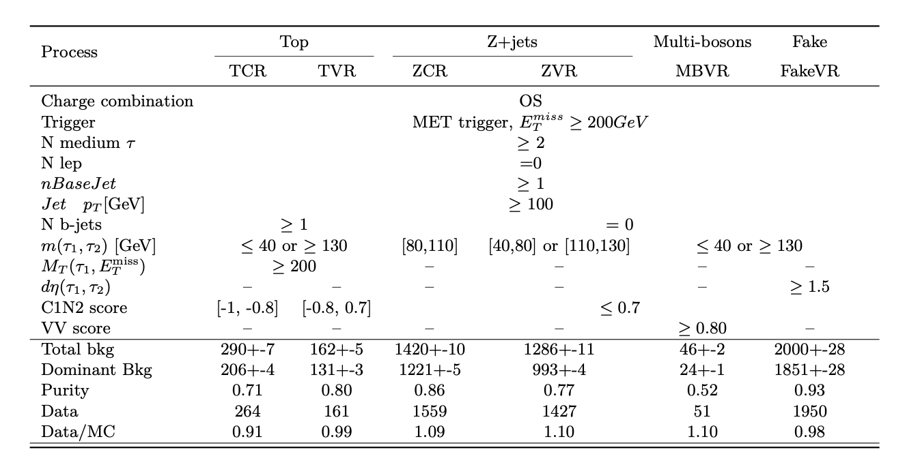
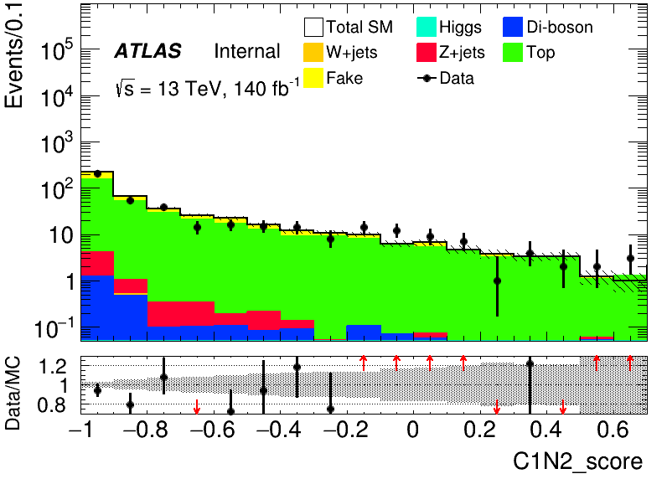
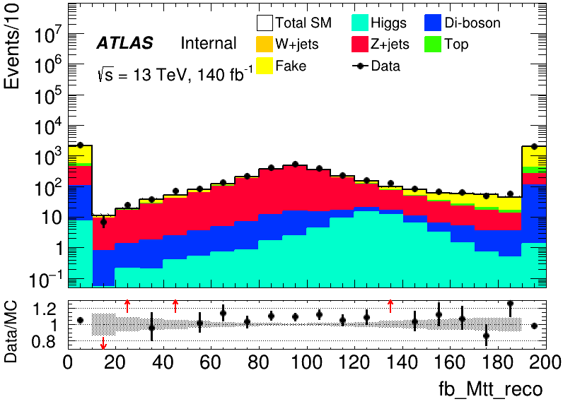
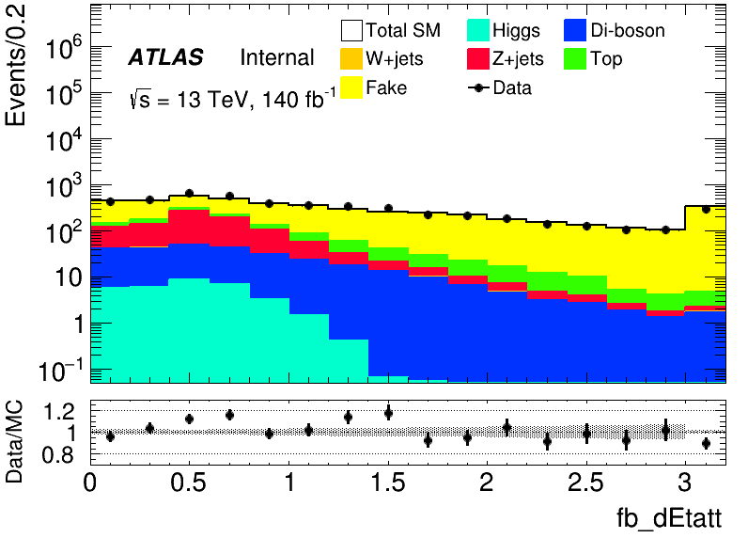
C1N2 ISR background estimation(HH)
Orthorgonal with SR
Top
Z+jets
VV
Fake
CR
VR
VR
CR
VR
VR
VR

Slide 14
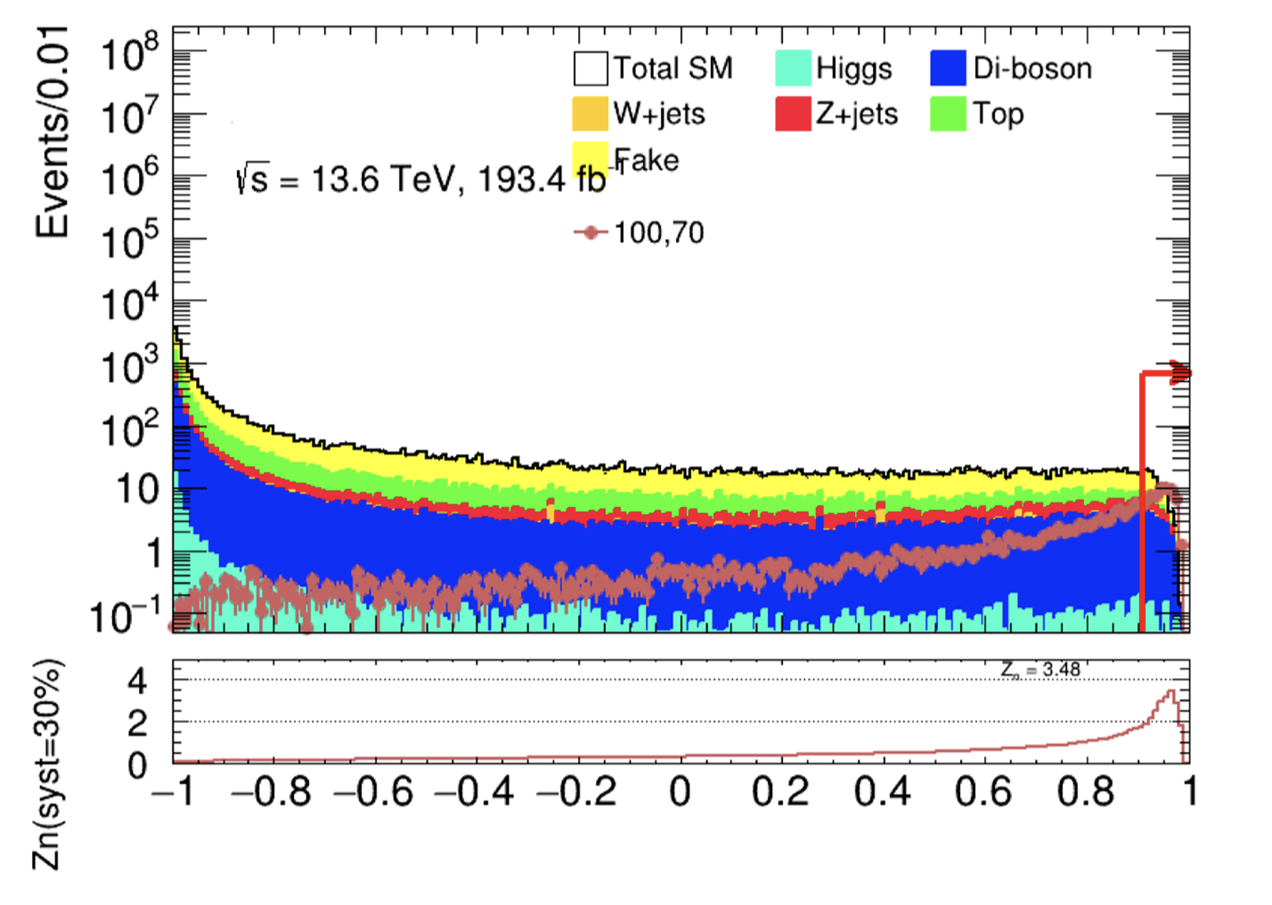
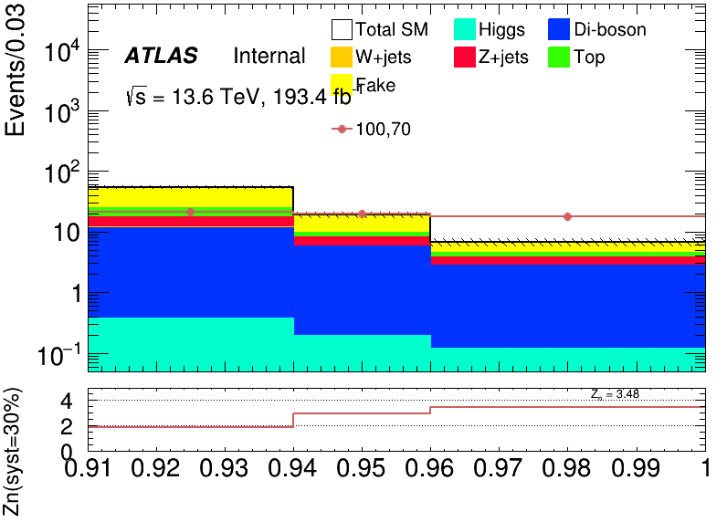
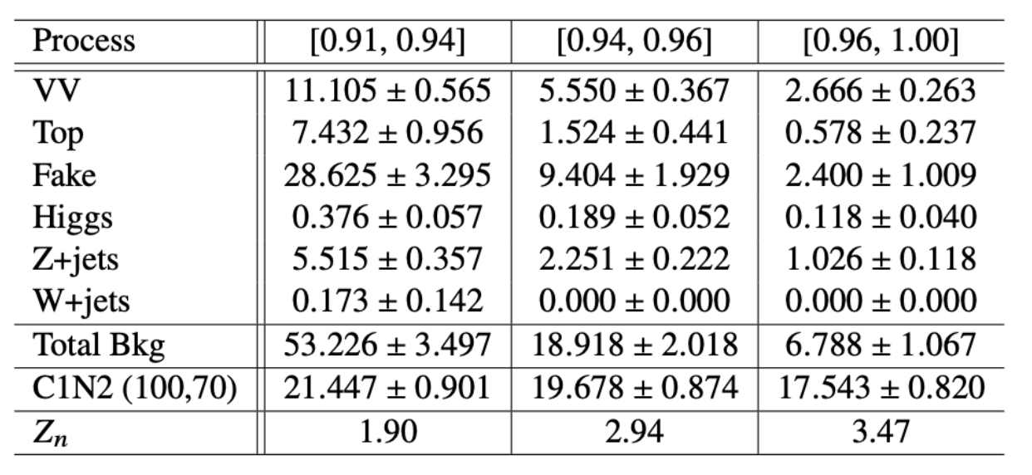
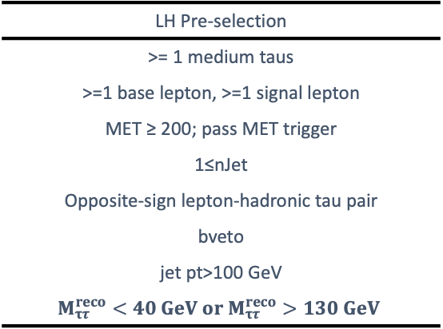
C1N2 ISR signal region definition(LH)
Combined Zn 4.934
SR definition using BDT score(LH)
Three bins [0.91, 0.94], [0.94, 0.96], [0.96, 1.00]
LH Pre-selection
>= 1 medium taus
>=1 base lepton, >=1 signal lepton
MET ≥ 200; pass MET trigger
1≤nJet
Opposite-sign lepton-hadronic tau pair
bveto
jet pt>100 GeV
$$M_{ττ}^{reco}<40 GeV or M_{ττ}^{reco}>130 GeV$$
SR
Pre-selection
BDT score > 0.91

Slide 15
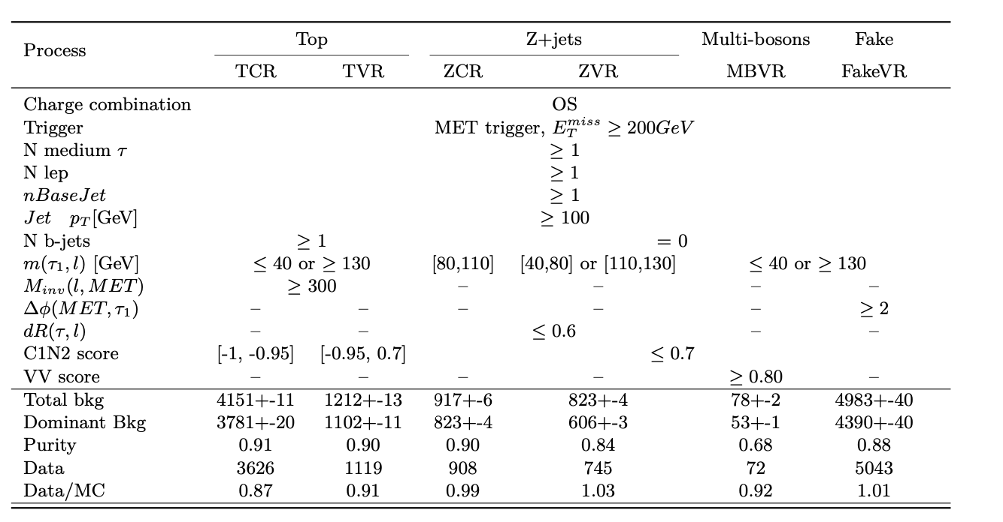
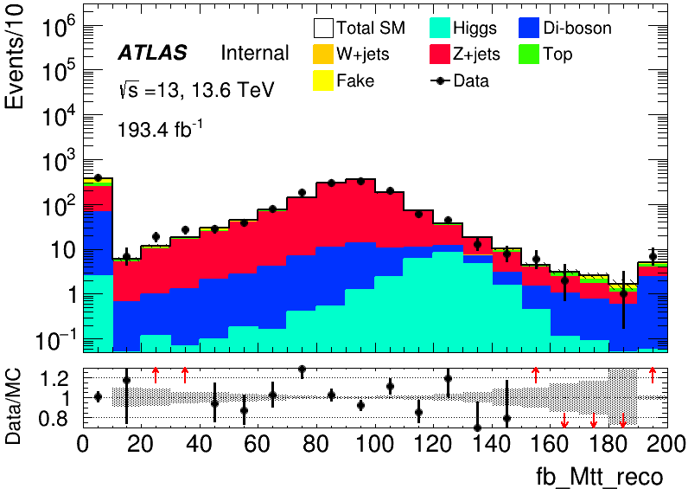
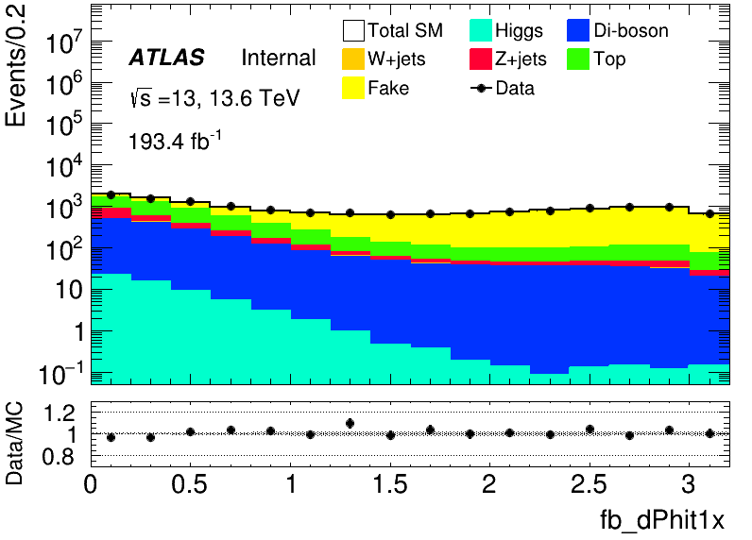
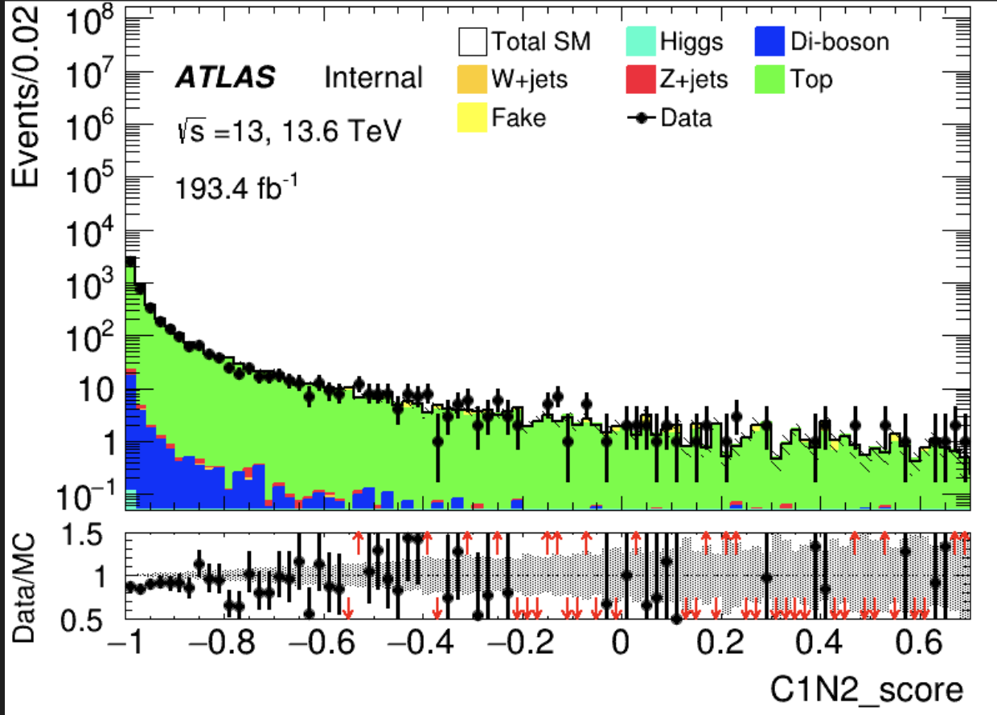
C1N2 ISR background estimation(LH)
Selection for control region and validation region
Z+jets
VV
Fake
Top
VR
VR
VR
VR
CR
VR
CR

Slide 16
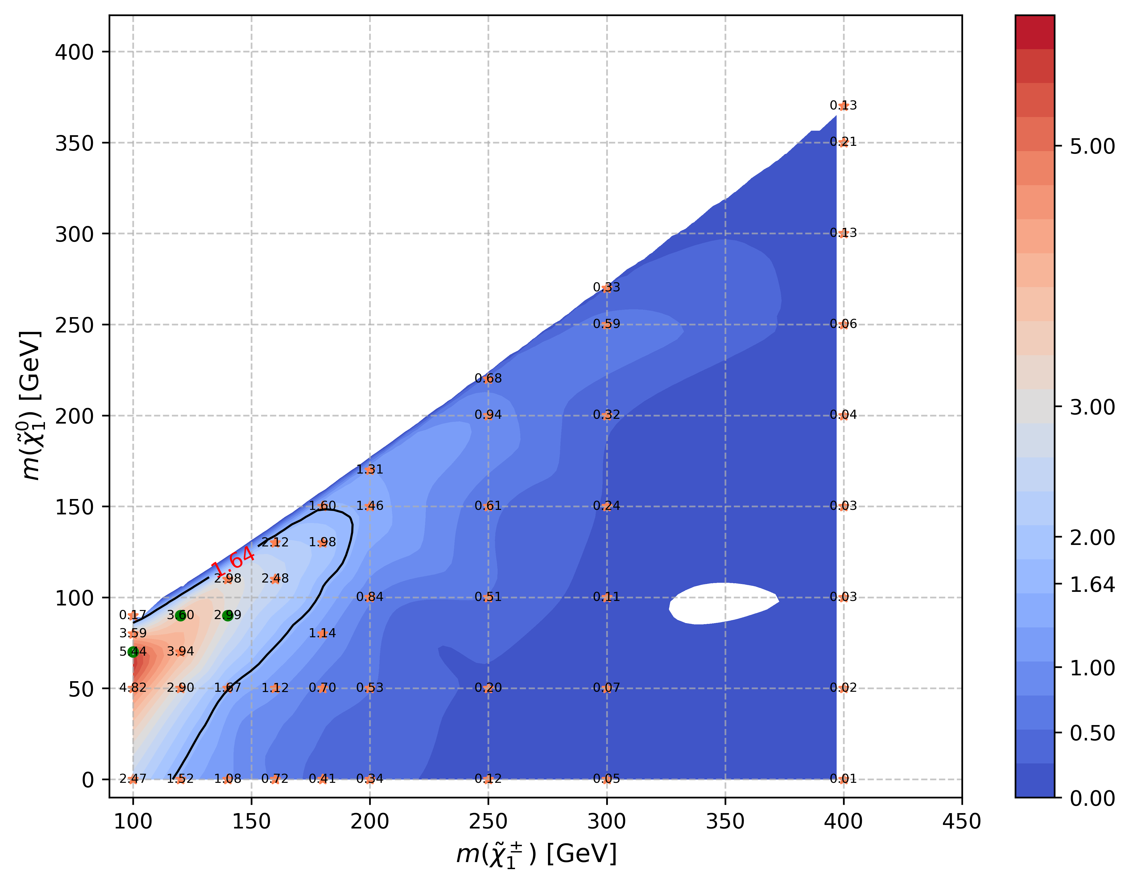
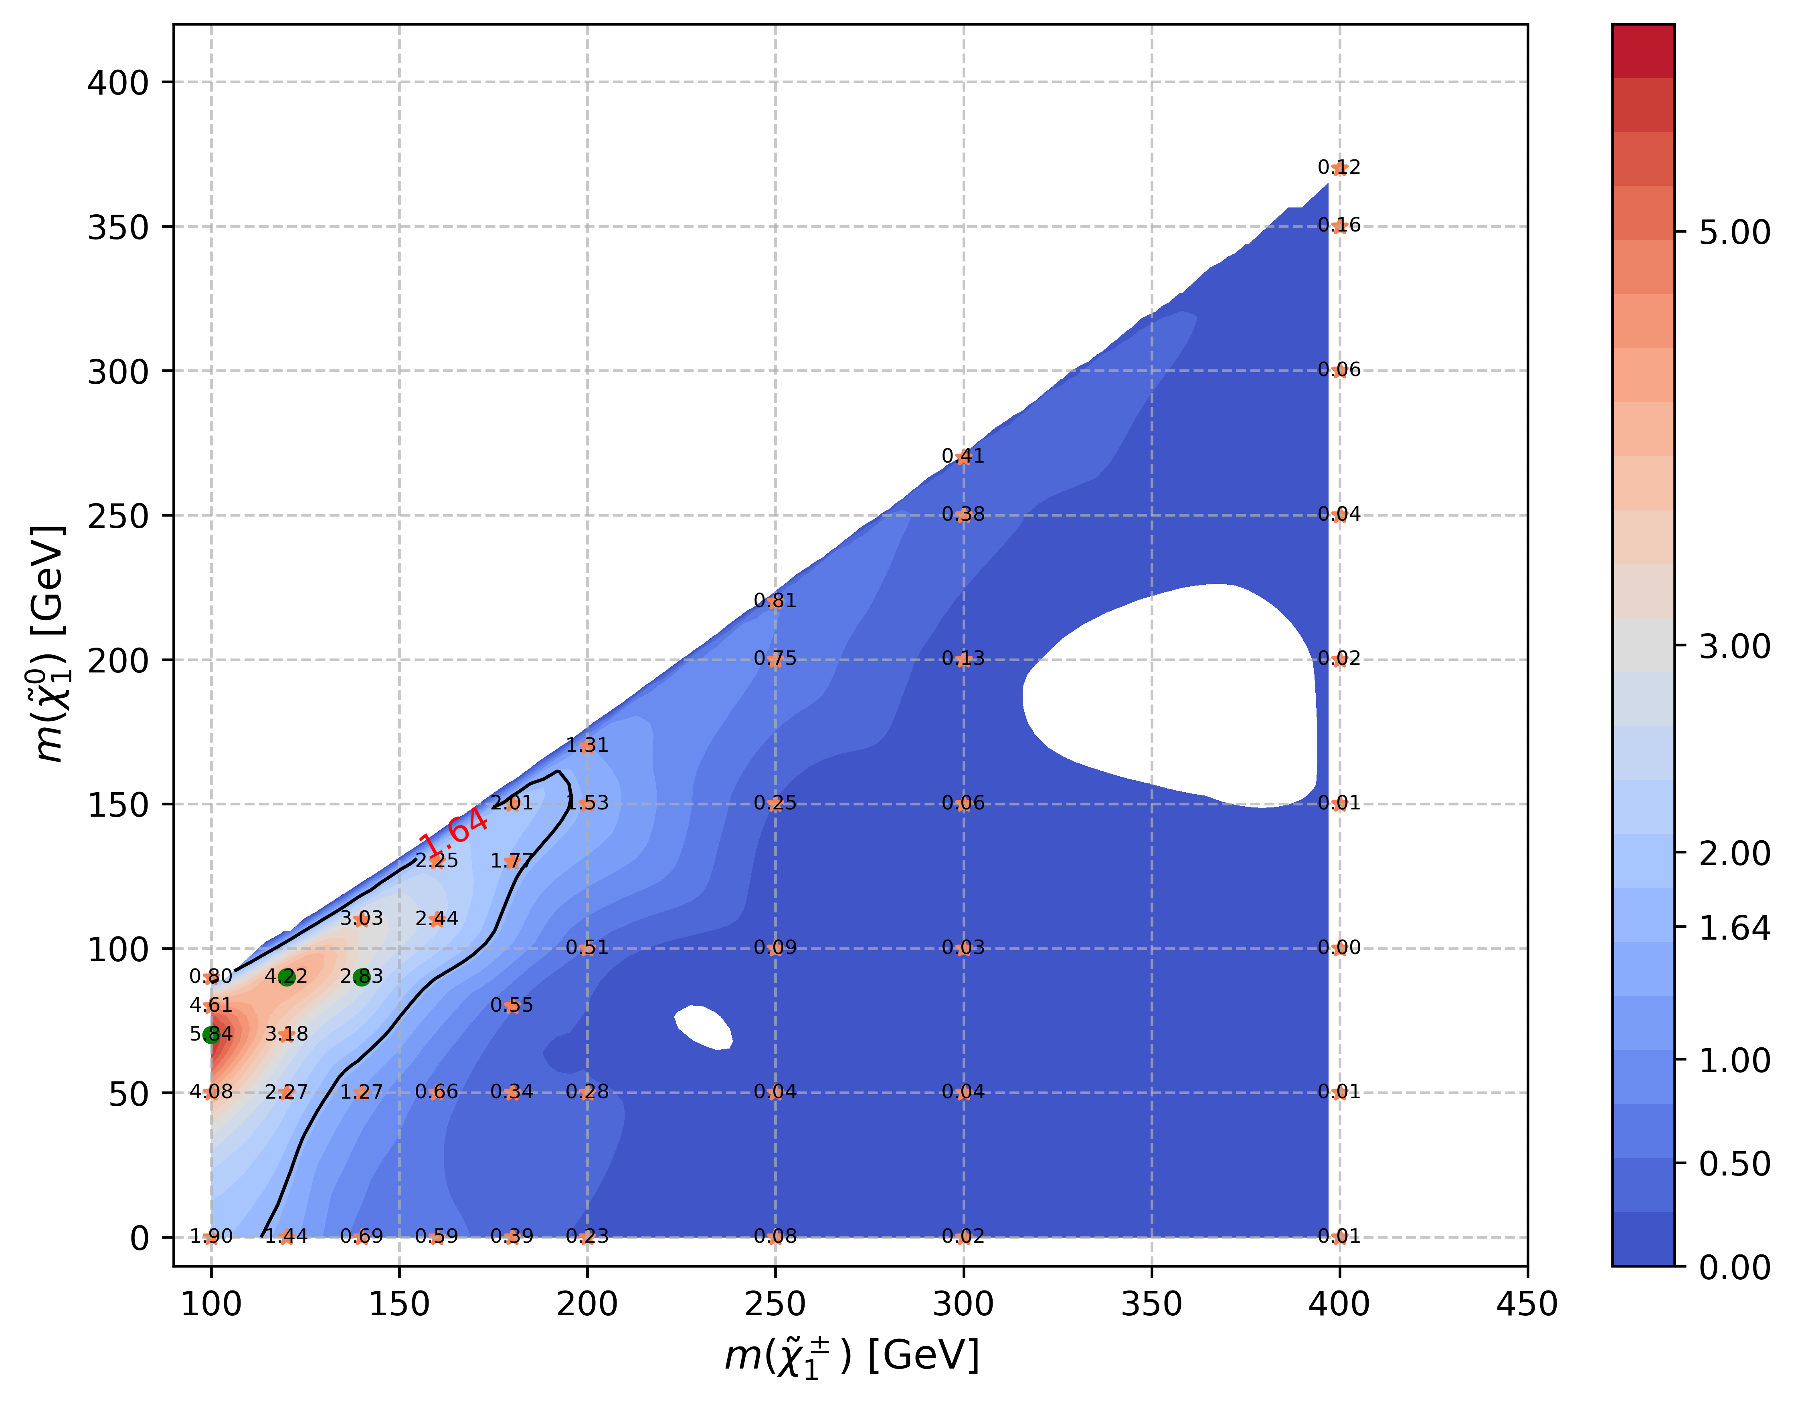
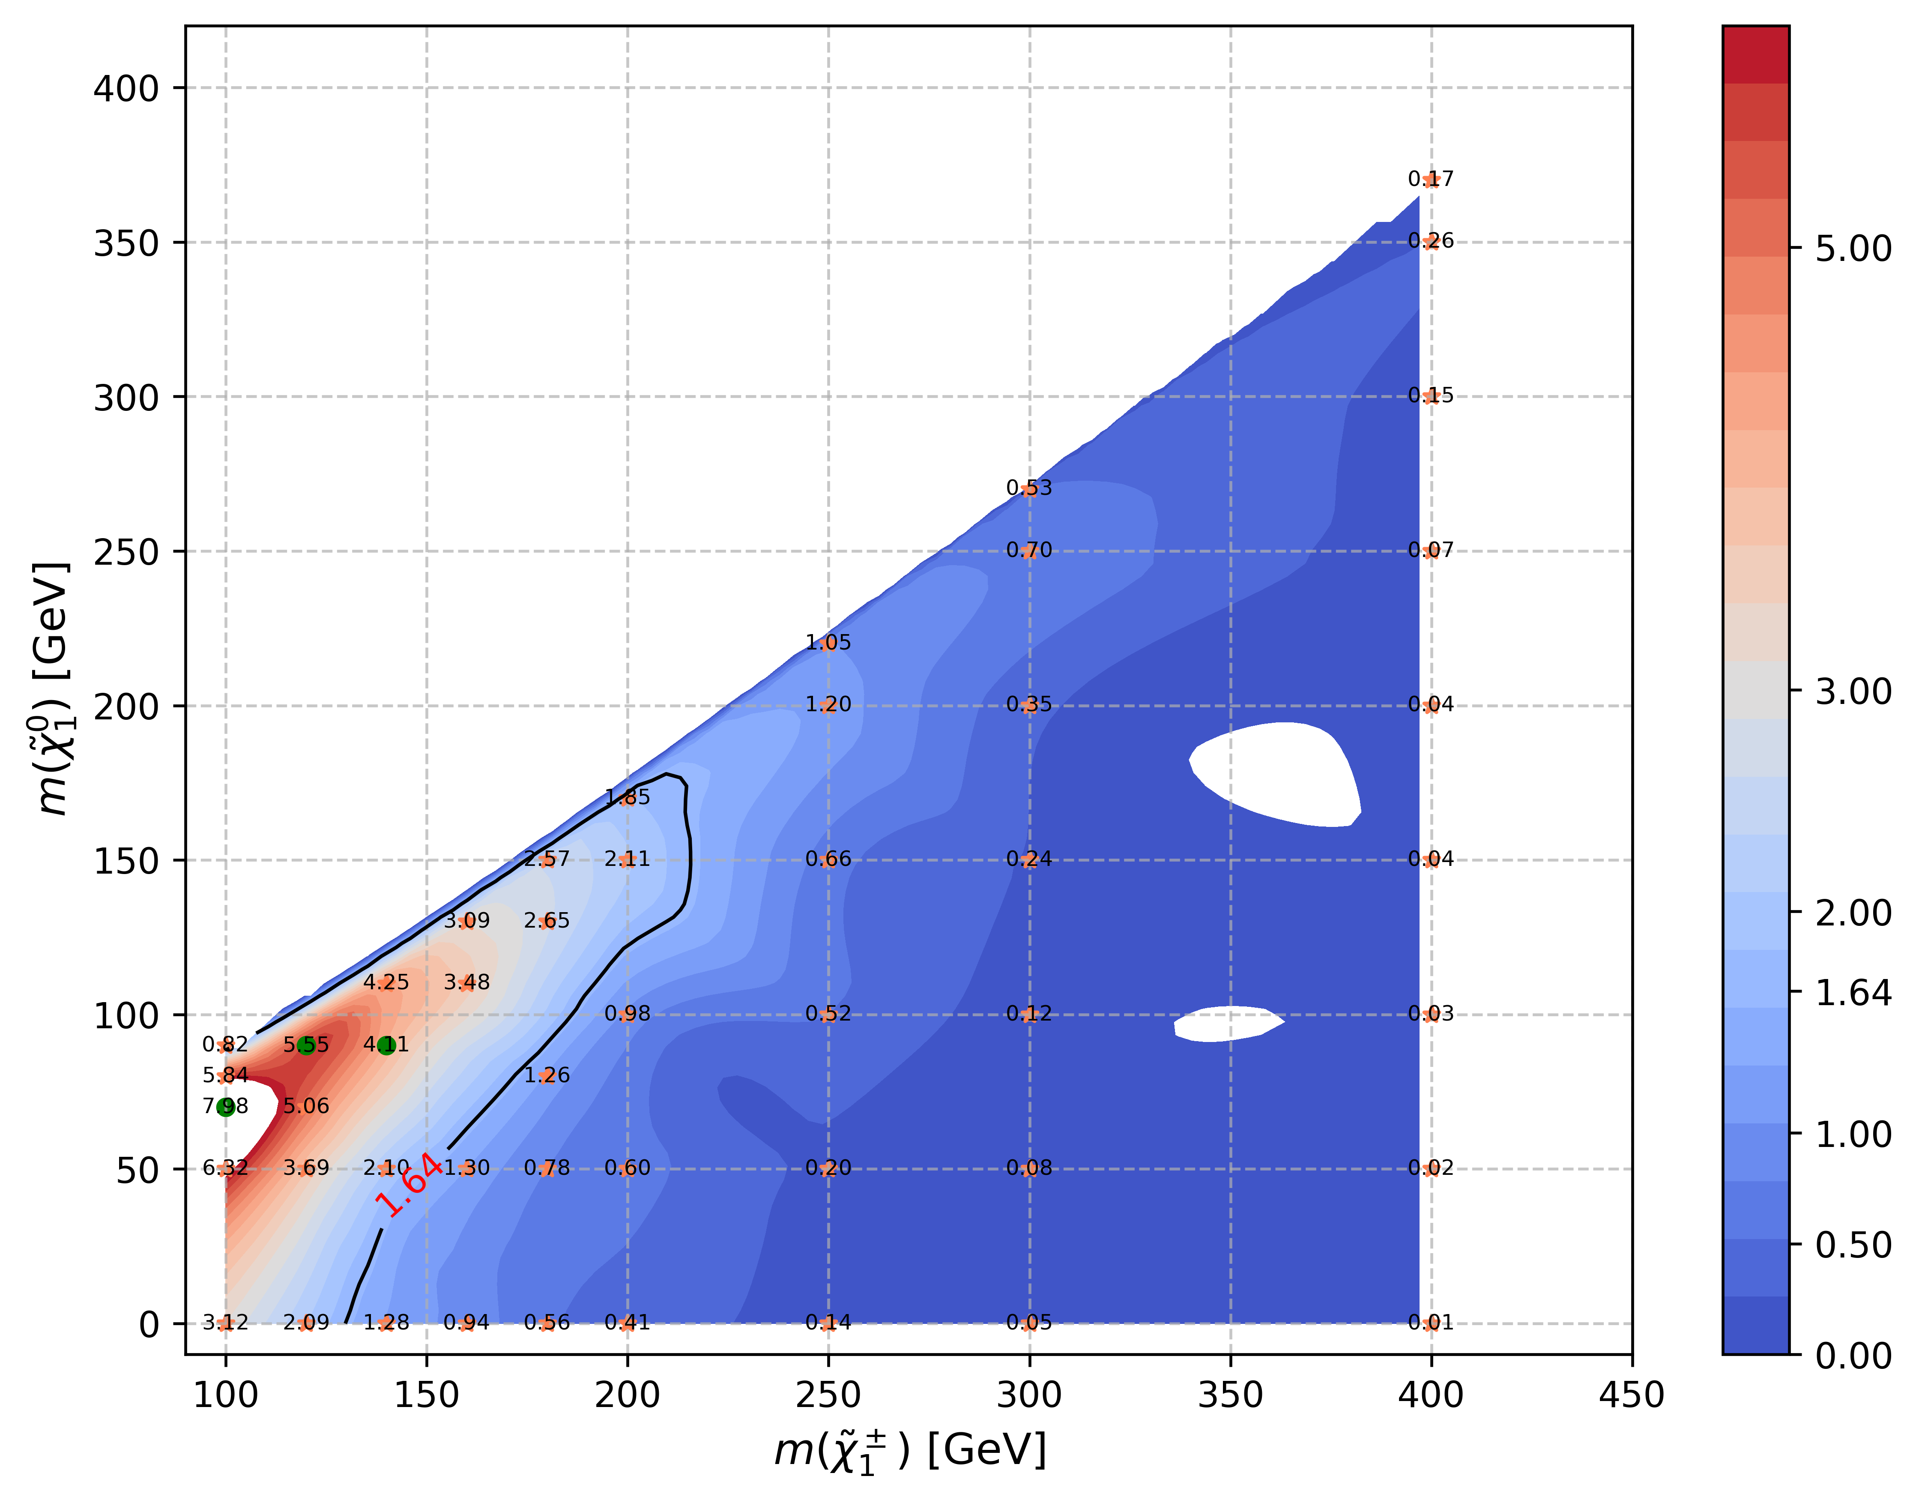
C1N2 ISR sensitivity map
Expected sensitivity
30% flat systematic uncertainty
gap caused by interpolation algorithm
Result only for full run2 sample, will update to full run2 + partial run3 sample later
HH channel
LH channel
Combined channel

Slide 17
Summary and Outlook
Contribution Note
Full analysis include SRs optimization, sensitivity map, background estimation, Internal note
Invited to give an approval talk
Summary
Initial result show good sensitivity to compressed region
TODO
Include more signal points the ML to expand exclusion limit
Systematics studies
Expected limit with uncertainty

Slide 18
Backup

Slide 19
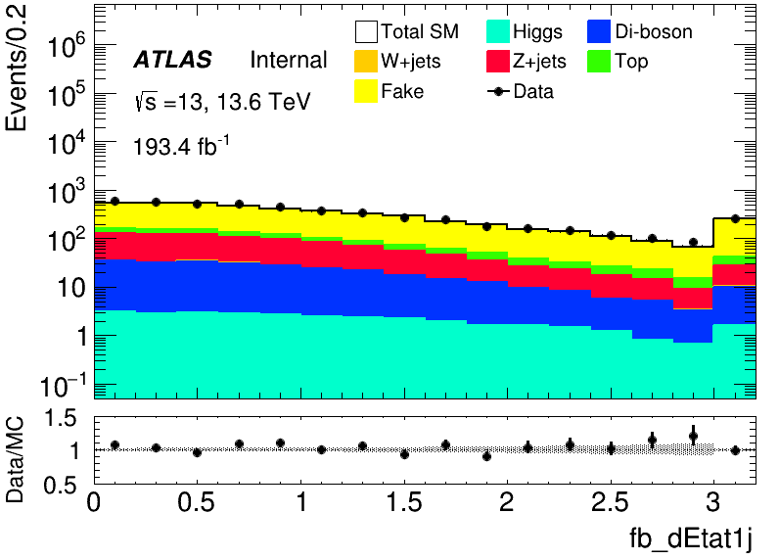
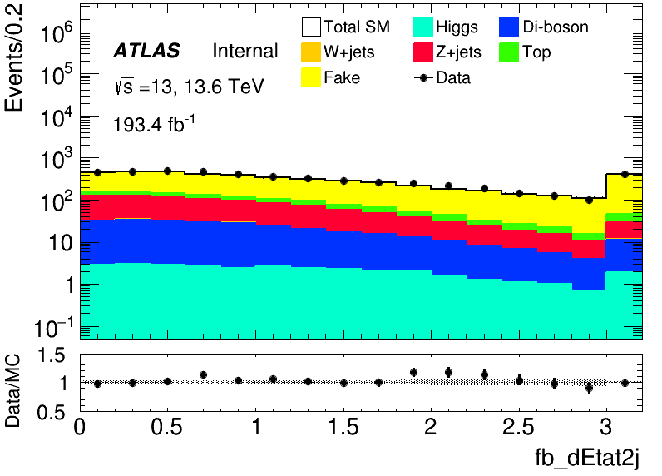






C1N2 ISR MC Modeling(HH)
Full run2 + partial run3 after data-driven

Slide 20








C1N2 ISR MC Modeling(LH)
Full run2 + partial run3 after data-driven

Slide 21

C1N2 ISR signal region optimization(HH)
Hyperparameters: Ntrees = 200, MaxDepth = 6, MinNodeSize = 2%, Learning rate = 0.03(initial setting)
Feature engineering: Select a simple model and put all features into model, choose Top 30 vars based on importance list, drop high correlated vars Final feature list:
Weight choose: no weight, abs(weight)
No weight have better performance but abs(weight) fit our anaysis requirment
Split strategy: Separate entries by using mod 5, for Fake bkg, if separate follow sequence, all weighted entry will split into first fold

Slide 22
C1N2 ISR signal region optimization(HH)
Class: C1N2, bkg
Hyperparameter tune: use optuna to auto-optimze
Test_auc = \sum{Test_auc_class} Train_auc = \sum{Train_auc_class}
constraint: average of AUC need to >= 0.6 penalty function: score = test_auc – 0.3*auc_gap (auc_gap = abs(train_auc- test_auc)) maximum(score)
Grid Search Ntrees: [200, 300, 400]
MaxDepth: [4, 6, 8, 10] MinNode: [1, 3, 5, 7]
Learning rate: [0.001, 0.005, 0.01, 0.05, 0.1]
Best one: Ntree=300, MaxDepth=6, MinNode=1%, Learning Rate=0.05
There still have rooms to optimize for lr

Slide 23





C1N2 ISR signal region optimization(HH)
Overfit Check

Slide 24




C1N2 ISR signal region optimization(HH)
50 bins
Cut at 0.8
rebin
Sum Zn = 7.65

Slide 25

C1N2 ISR signal region optimization(LH)
Hyperparameters: Ntrees = 200, MaxDepth = 6, MinNodeSize = 2%, Learning rate = 0.03(initial setting)
Feature engineering: Select a simple model and put all features into model, choose Top 30 vars based on importance list, drop high correlated vars Final feature list:
Weight choose: no weight, abs(weight)
No weight have better performance but abs(weight) fit our anaysis requirment
Split strategy: Separate entries by using mod 5, for Fake bkg, if separate follow sequence, all weighted entry will split into first fold

Slide 26





C1N2 ISR signal region optimization(LH)
Overfit Check

Slide 27




C1N2 ISR signal region optimization(LH)
100 bins
Cut at 0.91
rebin
Narrow peak
Sum Zn = 4.934

